Slide 1

Annuity 101
What is an annuity & what purpose do they serve

Slide 2
DEFINING THE TERM ANNUITY
(according to annuity.org)
An annuity is a customizable contract issued by an insurance company that converts an investor’s premiums into a guaranteed fixed income stream.
More specifically, an annuity contract is a legally binding, written agreement between you and the insurance company that issues the contract. This contract transfers your longevity risk — the risk of you outliving your savings — to the insurance company. In exchange, you pay premiums as outlined in the contract.

Slide 3
BREAKING THAT DOWN TO THE BASICS
Guaranteed contract – it is an insurance product
Backed by state guarantee fund - not FDIC
Companies go through 3rd party audit to prove solvency 1:1
Clients must qualify for this product unlike other investments
Financial suitability – not health related
Customizable - Lump sum vs multi-premium, income vs growth, etc
MOST IMPORTANT – provides protection for retirement

Slide 4



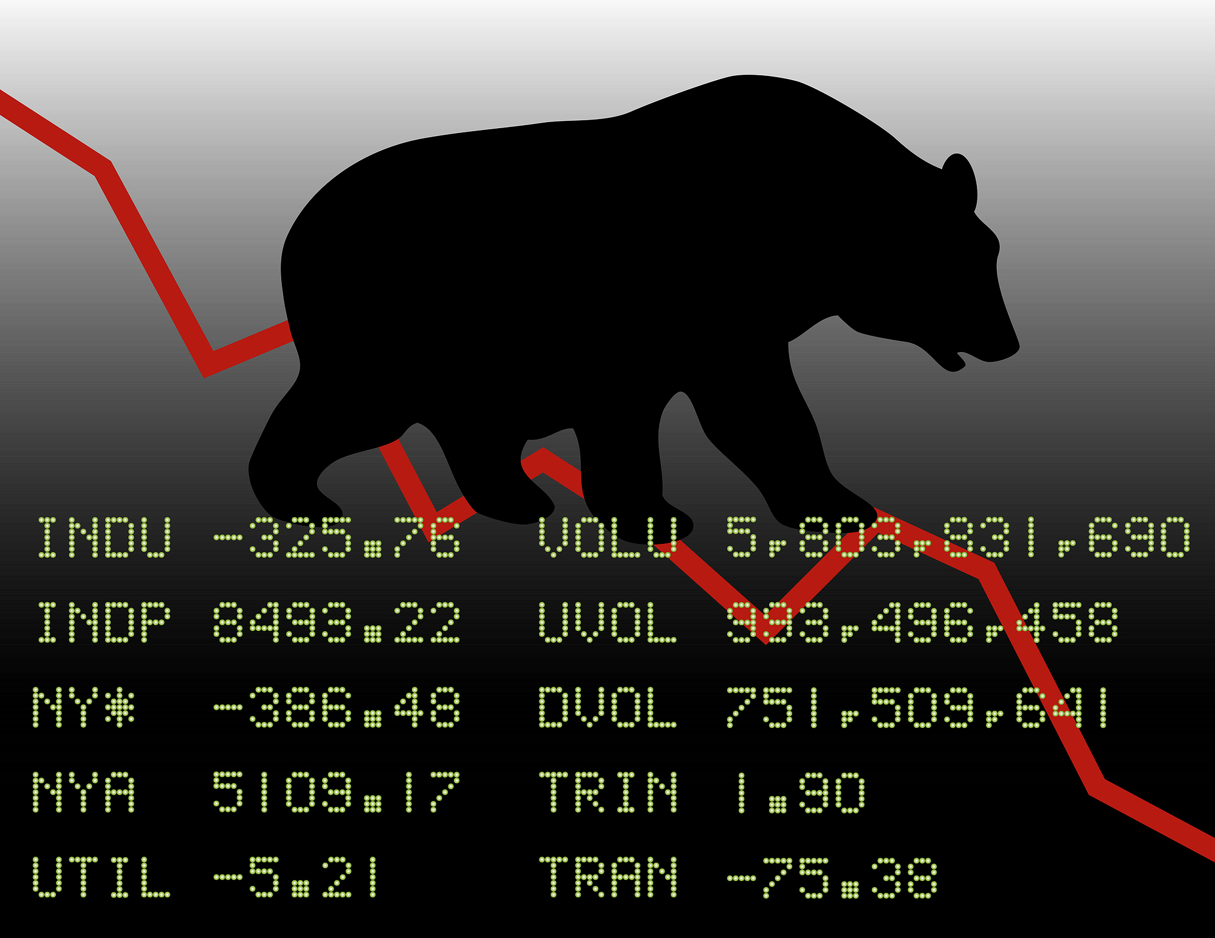
MAIN GOAL OF AN ANNUITY:
PROTECTING RETIREMENT – WITH INSURANCE
0.276% chance you have a house fire next year *
1% chance a term life policy pays out a claim***
5.5% chance you have an auto insurance claim next year **
26.3% chance the market goes down next year ****
* https://www.usfa.fema.gov/
** https://www.nhtsa.gov/
***https://www.thezebra.com/resources/research/life-insurance-statistics
**** https://www.slickcharts.com/sp500/returns

Slide 5
PROTECTING RETIRMENT WITH AN FIA
The Fixed Indexed Annuity (FIA) is the fastest growing tool for retirees today. It is popular because it is not an investment of risk, but a guaranteed contract that provides the following:
ELIMINATE market loss – never lose money in the market again!
PARTICIPATE in the upside of the market – much higher earning potential than other safe investments!
Create a PAYCHECK FOR LIFE for you and your spouse – ONLY annuities can provide this!

Slide 6
Types of Money Used for an Annuity
Non-Qualified
Post-tax money – this is money that you have already paid taxes on (but note you will have taxes later the gains).
Savings accounts
CDs
Money Market
Cash under the mattress
Checking accounts
Cash from sale of certain assets – vehicles, houses, collectibles, etc
Qualified
Pre-tax money – this is money that you have NOT paid taxes on (except for ROTH).
IRA
SEP IRA
ROTH IRA
TSP
Pension
401K
403B

Slide 7
WHO MAKES A GOOD ANNUITY CLIENT
Lump sum vs monthly premiums
Qualified money – Can’t pay for insurance (ladder approach)
Health conditions that limit coverage or make it too expensive
Enough insurance in place but still want to set aside funds
Self Insuring – can’t be convinced of insurance because enough assets
Older clients - we have annuity options up to age 90
Low risk tolerance individuals
Retirees – transition of some assets to safer investments 60/40

